Slide 1
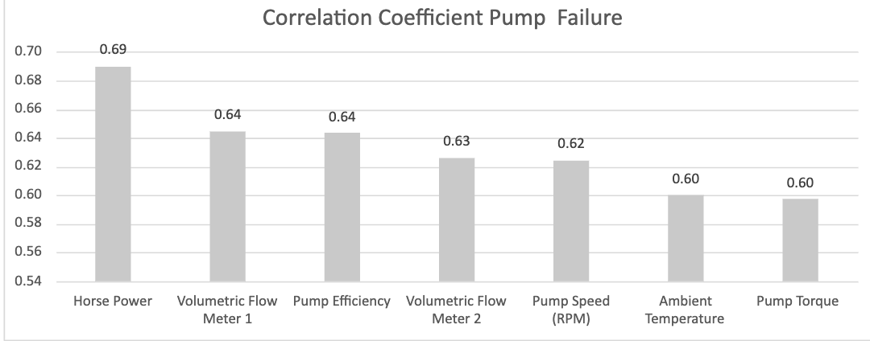
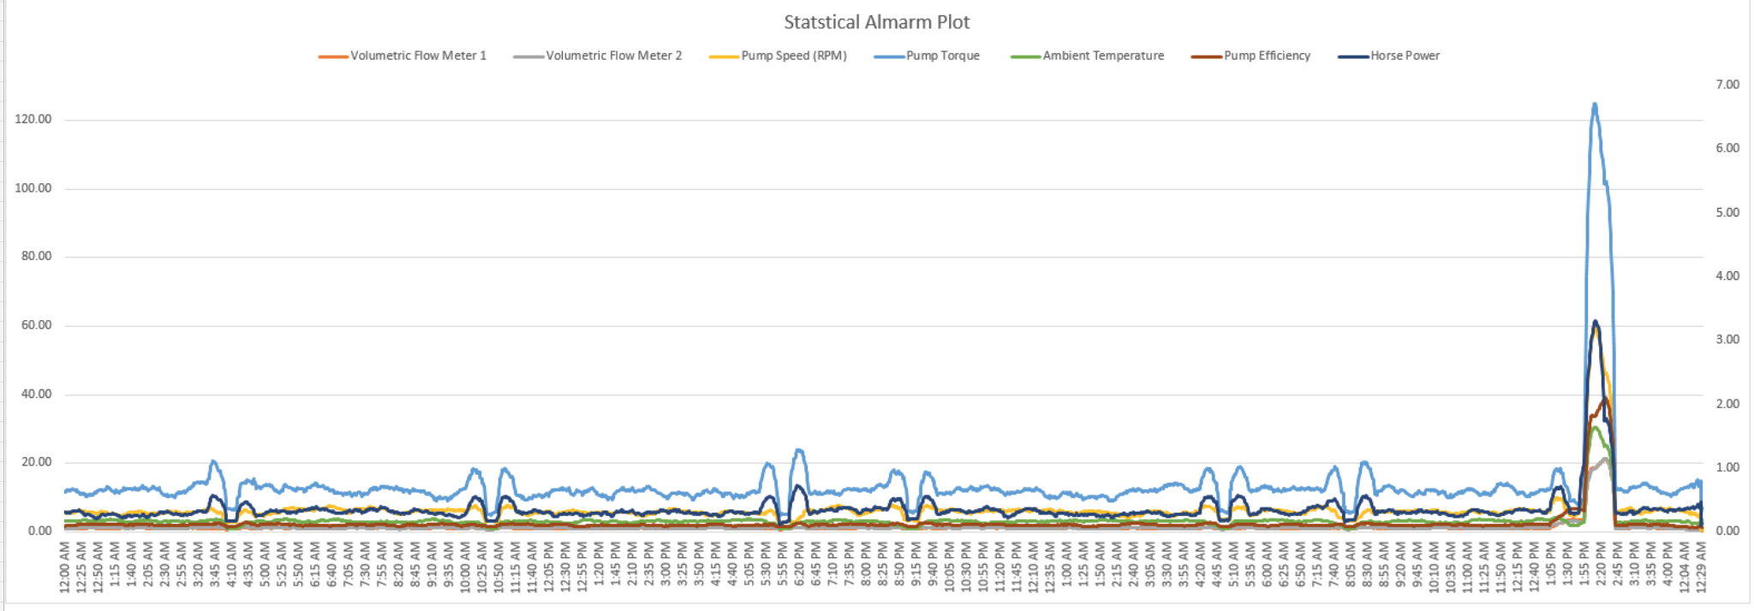
Descriptive and inferential statistical methodologies have proven effective in creating a proactive ‘alarm’, accurately identifying Pump Failures with Horse Power (HP) and Pump Efficiency (PE) emerging as key variables of interest with deviations of 15 HP and > 3 % PE being our core signal thresholds.

Slide 2
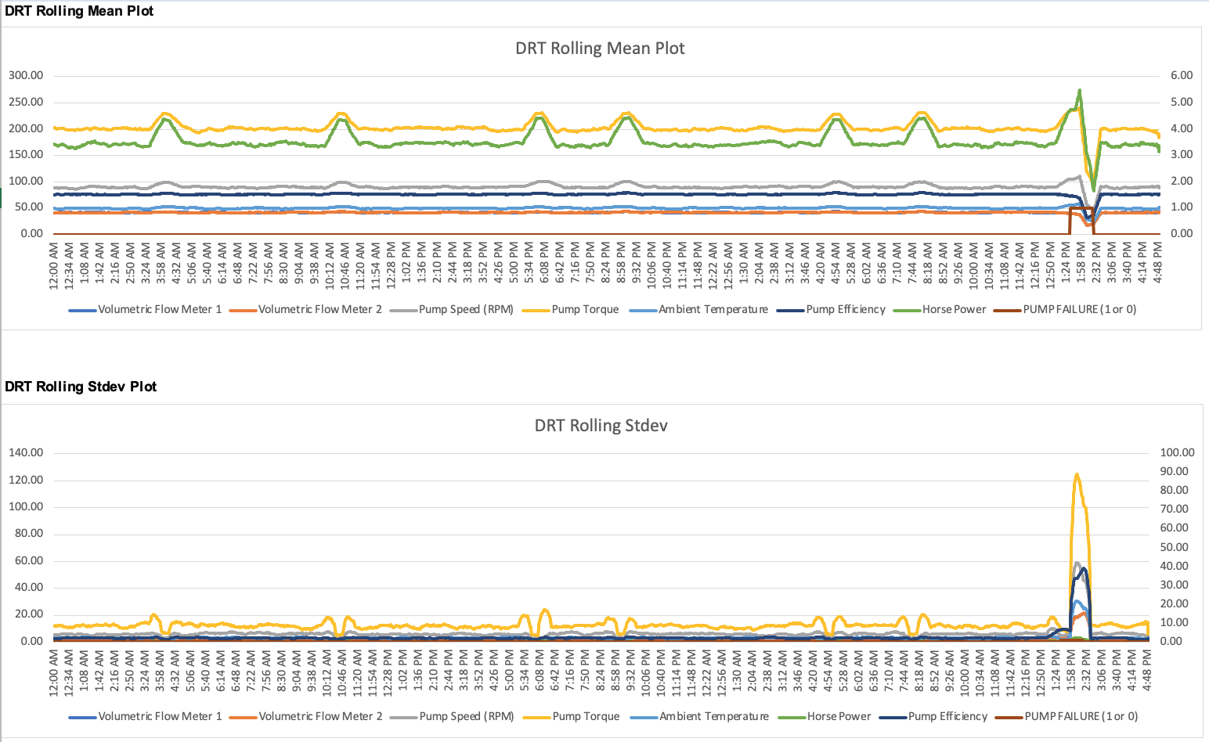
Descriptive Analysis has enabled us to clearly identify particular signature abnormalities showing clear signature changes in both Rolling Standard Deviation and Rolling Mean Datasets when observed over the respective failure period of interest.

Slide 3
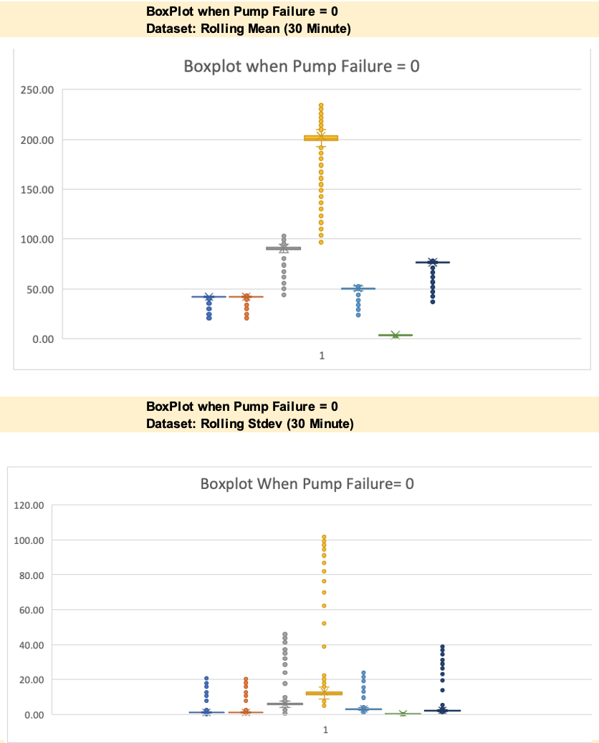
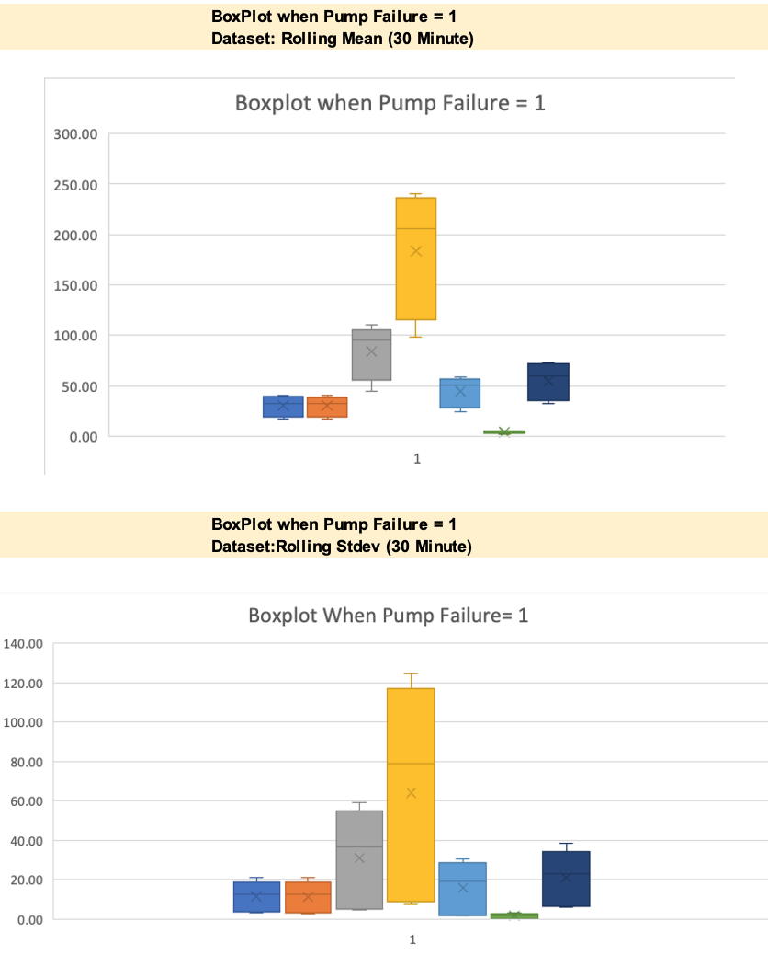
Further segmentation of the data via binary means (Pump Failure = 0 or 1) illustrated through Box-Plots, show a clear signature difference between that of normal behaviour and that of Failure with Pump Torque, Pump Speed , Pump Efficiency showing the 3 largest variances.
Note: We’ve included a sample headline for you – you can feel free to use this or modify this as you see fit

Slide 4
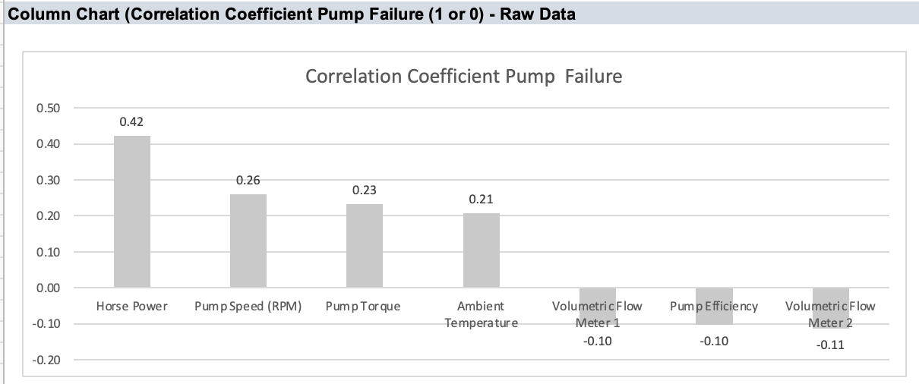
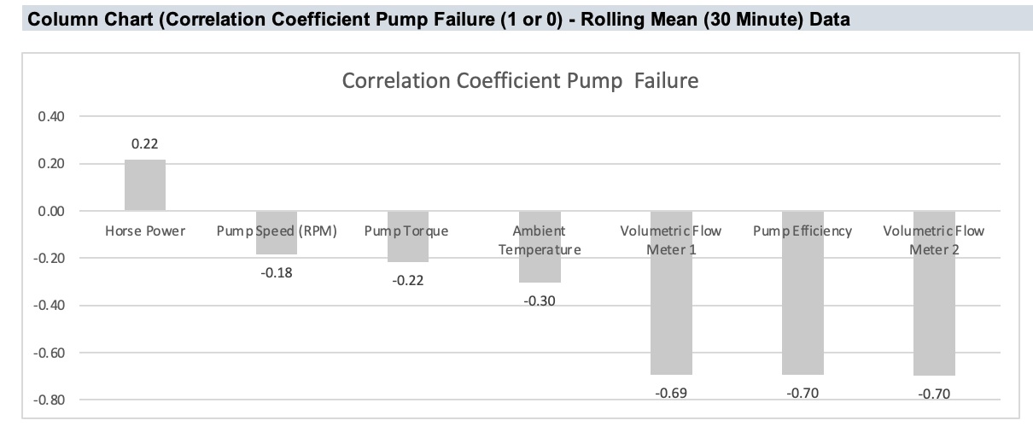
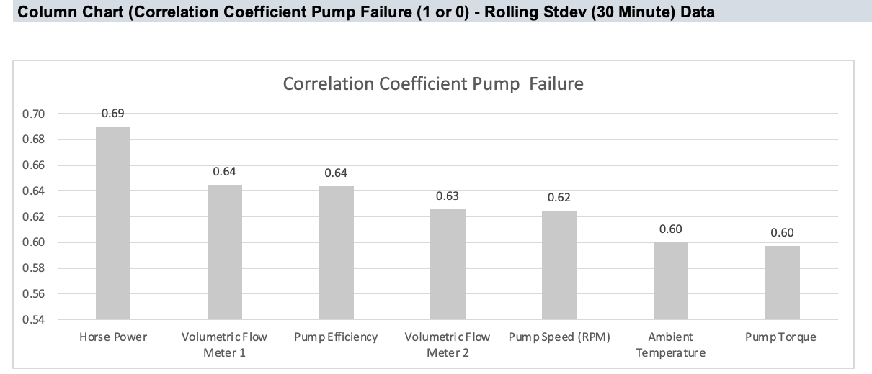
Correlation analyses across datasets yield interesting insights with Pump Efficiency and Volumetric Flow Meter 1 and 2 negatively correlated with Pump Failure as seen in the Rolling Mean and Rolling Standard Deviation Data, whilst Horse Power and Pump Speed show a subsequently strong positive correlation in the Rolling Mean and Rolling Stdev Dataset.

Slide 5
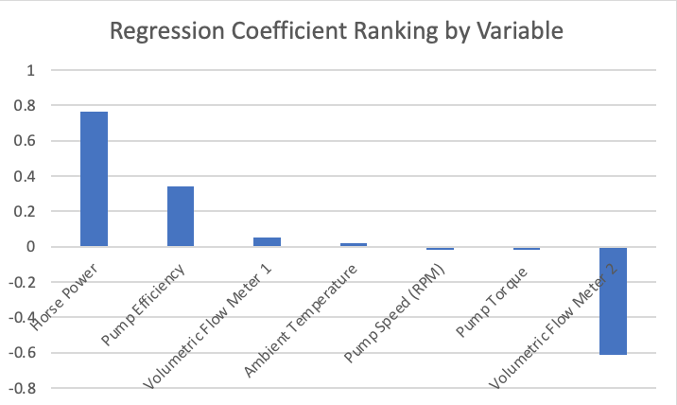
Lastly, analysis of the model fit reveals that with a R Squared of >.7, a linear model is a good fit for the data with variables Horsepower, Pump Efficiency and Volumetric Flow Meter 1 having the largest coefficients, indicative that these variables have the most immediate relationship with respect to Pump Failure behaviour.

